Slide 1
Strings in Python

Slide 2
Check Validity of a PAN
In any of the country's official documents, the PAN number is listed as follows
<alphabet>< alphabet> < alphabet > < alphabet >
< alphabet > <digit><digit><digit><digit>< alphabet >
Your task is to figure out if the PAN number is valid or not. A valid PAN number will have all its letters in uppercase and digits in the same order as listed above.

Slide 3
PAC For Chocolate Problem
Input | Processing | Output
PAN number | Take each character and check if alphabets and digits are appropriately placed | Print Valid or Invalid

Slide 4
Pseudocode
READ PAN
If length of PAN is not ten then print “Invalid” and exit
FOR x=0 to5
if PAN[x] is not a character THEN
PRINT ‘invalid’
BREAK;
END IF
END FOR
FOR x=5 to 9
if PAN[x] is not a digit THEN
PRINT ‘invalid’
BREAK;
END IF
END FOR
IF PAN[9] is not a character THEN
PRINT ‘invalid’
END IF
PRINT ‘valid’

Slide 5
Test Case 1
abcde1234r
Valid

Slide 6
Test Case 2
abcde12345
Invalid

Slide 7
Test Case 3
abcd01234r
Invalid

Slide 8
Strings
Immutable sequence of characters
A string literal uses quotes
'Hello' or "Hello“ or ‘’’Hello’’’
For strings, + means “concatenate”
When a string contains numbers, it is still a string

Slide 9
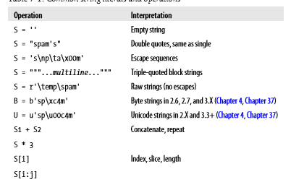
String Operations
Notes:
Escape sequences
>>> s='s\np\tp\x00m'
>>> print(s)
s
p p m
Repetition
>>> s='bob'
>>> s*3
'bobbobbob’
Indexing
>>> s='Bobby'
>>> s[4]
‘y’
Slicing
>>> s='Bobby'
>>> s[1:3]
'ob'

Slide 10
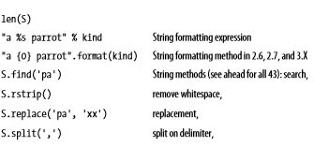
String Operations
Notes:
String length
>>> s='Bobby'
>>> len(s)
5
String Formatting Expression
>>> s="a %s parrot" % 'kind'
>>> print(s)
a kind parrot
OR
>>> s="a {0} parrot".format('kind')
>>> print(s)
a kind parrot
String method: search
>>> s='bobby'
>>> s.find('bb’)
2
Remove whitespace
>>> s='bobby '
>>> s.rstrip()
'bobby'
>>> s='bobbyyyyyyyy'
>>> s.rstrip('y')
'bobb’
Replace
>>> s='bobby'
>>> s.replace('bb','mm')
'bommy’
Split on delimiter
>>> s='bob,by'
>>> s.split(',')
['bob', 'by']

Slide 11
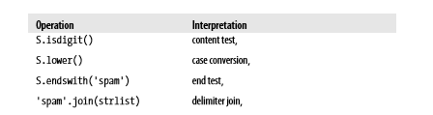
String Operations

Slide 12
Example Strings
Single quotes: 'spa"m'
Double quotes: "spa'm"
Triple quotes: '''... spam ...''', """... spam ..."""
Escape sequences: "s\tp\na\0m“
Raw strings: r"C:\new\test.spm"

Slide 13
Escape Sequences
Represent Special Characters
>>> s = 'a\nb\tc'
>>> print(s)
a
b c
>>> len(s)
5

Slide 14
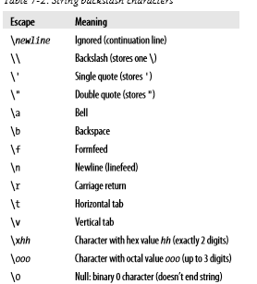
Escape Sequences

Slide 15
Length of a String
>>> s = ‘bobby’
>>> len(s)
5
>>> print(s)
a b c

Slide 16
Backslash in Strings
if Python does not recognize the character after a \ as being a valid escape code, it simply keeps the backslash in the resulting string:
>>> x = "C:\py\code"
# Keeps \ literally (and displays it as \\)
>>> x
'C:\\py\\code'
>>> len(x)
10

Slide 17
Backslash in Strings
>>> x = "C:\py\code"
>>> x
'C:\\py\\code'
>>> len(x)
10

Slide 18
Check this
s = "C:\new\text.dat“
>>>s
print(s)
s1 = r"C:\new\text.dat“
>>>s1
print(s1)
s2 = "C:\\new\\text.dat“
print(s2)
>>>s2
Notes:
>>> s2 = "C:\\new\\text.dat"
>>> print(s2)
C:\new\text.dat

Slide 19
Opening a File
myfile = open('C:\new\text.dat', 'w') - Error
myfile = open(r'C:\new\text.dat', 'w')
Alternatively two backslashes may be used
myfile = open('C:\\new\\text.dat', 'w')
>>> path = r'C:\new\text.dat'
>>> print(path) # User-friendly format C:\new\text.dat
>>> len(path)
15

Slide 20
Basic Operations
>>> 'Ni!' * 4
'Ni!Ni!Ni!Ni!‘
>>> print('-' * 80) # 80 dashes, the easy way
>>> myjob = "hacker"
>>> for c in myjob:
print(c, end=' ')
h a c k e r

Slide 21
Basic Operations
>>> for c in ‘myjob’:
print(c, end=' ')
h a c k e r

Slide 22
Using ‘in’ Operator in Strings
>>> "k" in myjob # Found
True
>>> "z" in myjob # Not found
False
>>> 'spam' in 'abcspamdef'
# Substring search, no position returned
True
Notes:
>>> myjob='hacker'
>>> "k" in myjob
True
>>> "z" in myjob
False

Slide 23
Counting
Count the number of ‘a’

Slide 24
Counting
Count the number of ‘a’
Example
word = 'Btechallbranches'
count = 0
for letter in word :
if letter == 'a' :
count = count + 1
print(count)

Slide 25
Indexing and Slicing
>>> S = 'spam'
Last character in the string has index -1 and the one before it has index -2 and so on

Slide 26
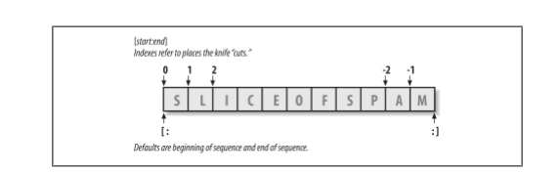
Indexing and Slicing

Slide 27
Indexing
Take one letter from a word at a time
Use square bracket and give the index of the letter to be extracted
Indexing can be done either from front or from end
>>> S[0], S[−2]
('s', 'a')

Slide 28
Slicing
Take a part of a word
Square bracket with two arguments with a colon
First value indicates the starting position of the slice and second value indicates the stop position of the slice
Character at the stop position is not included in the slice
>>> S[1:3]
'pa’
Notes:
>>> s="sliceofspam"
>>> s[1:3]
'li'

Slide 29
Slicing
If the second number is beyond the end of the string, it stops at the end
If we leave off the first or last number of the slice, it is assumed to be beginning or end of the string respectively
s = ‘spam’
>>>s[:3]
‘spa’
>>>s[1:]
‘pam’

Slide 30
Properties of Slicing
S[1:3] - fetches items at offsets 1 up to but not including 3.
S[1:] - fetches items at offset 1 through the end
S[:3] - fetches items at offset 0 up to but not including 3
S[:−1] - fetches items at offset 0 up to but not including last item
S[:] - fetches items at offsets 0 through the end—making a top-level copy of S

Slide 31
Extended slicing
X[I:J:K] - means “extract all the items in X, from offset I through J−1, by K.”
Third limit, K, defaults to +1
If you specify an explicit value it is used to skip items
Extraction is reversed when negative value is given for K-1
Each time K-1 items are skipped

Slide 32
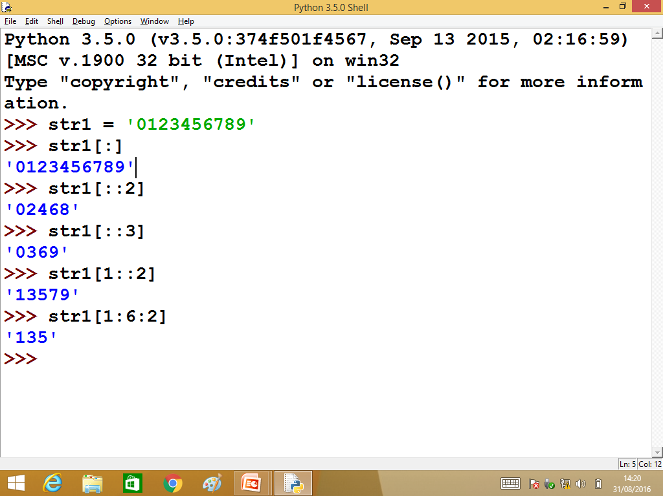

Slide 33
Extended slicing Examples
>>> S = 'abcdefghijklmnop'
>>> S[1:10:2] # Skipping items
'bdfhj'
>>> S[::2]
'acegikmo‘
>>> S = 'hello'
>>> S[::−1] # Reversing items
'olleh'

Slide 34
Extended slicing Examples
>>> S = 'hello'
>>> S[::−1] # Reversing items
'olleh'

Slide 35
String Conversion Tools
>>> "42" + 1
TypeError: Can't convert 'int' object to str implicitly
>>> int("42"), str(42) # Convert from/to string
(42, '42')
int("42") + 1
43
>>> "42" + str(1)
'421'

Slide 36
Character code Conversions
ord () - Convert a single character to its underlying integer code (e.g., its ASCII byte value)— this value is used to represent the corresponding character in memory.
>>> ord('s')
115

Slide 37
Character code Conversions
chr () – Does inverse of ord
>>> chr(115)
's'

Slide 38
Character code Conversions - Example
>>> S = '5'
>>> S = chr(ord(S) + 1)
>>> S
'6‘
>>> S = chr(ord(S) + 1)
>>> S
'7'

Slide 39
Character code Conversions - Example
>>> ord('5') - ord('0')
5
>>> int('1101', 2) # Convert binary to integer
13
>>> bin(13) # Convert integer to binary
'0b1101'

Slide 40
Concatenation
>>>S1 = ‘Welcome’
>>>S2 = ‘Python’
>>>S3 = S1 + S2
>>>S3
'WelcomePython'

Slide 41
Changing Strings
String - “immutable sequence”
Immutable - you cannot change a string in place
>>> S = 'spam'
>>> S[0] = 'x' # Raises an error!
TypeError: 'str' object does not support item assignment

Slide 42
Changing Strings
>>> S = S + 'SPAM!'
# To change a string, make a new one
>>> S
'spamSPAM!'
>>> S = S[:4] + 'Burger' + S[−1]
>>> S
'spamBurger!'

Slide 43
Replace
>>> S = 'splot'
>>> S = S.replace('pl', 'pamal')
>>> S
'spamalot'

Slide 44
Formatting Strings
>>> 'That is %d %s bird!' % (1, 'dead')
That is 1 dead bird!
>>> 'That is {0} {1} bird!'.format(1, 'dead')
'That is 1 dead bird!'
Notes:
>>> 'That is {0} {0} bird!'.format(1, 'dead')
'That is 1 1 bird!'
>>> 'That is {1} {1} bird!'.format(1, 'dead')
'That is dead dead bird!'

Slide 45
String Library
Python has a number of string functions which are in the string library
These functions do not modify the original string, instead they return a new string that has been altered

Slide 46
String Library
>>> greet = 'Hello Arun'
>>> zap = greet.lower()
>>> print (zap)
hello arun
>>> print (‘Hi There'.lower())
hi there

Slide 47
Searching a String
find() - function to search for a string within another
find() - finds the first occurrence of the substring
If the substring is not found, find() returns -1
>>> name = 'pradeepkumar‘
>>> pos = name.find('de')
>>> print (pos)
3

Slide 48
Searching a String
>>> aa = “fruit”.find('z')
>>> print (aa)
-1
>>> name = 'pradeepkumar‘
>>> pos = name.find('de‘,5,8)
>>>pos
-1

Slide 49
Other Common String Methods in Action
>>> line = "The knights who say Ni! “
>>> line.rstrip()
'The knights who say Ni!'
>>> line.upper()
'THE KNIGHTS WHO SAY NI!‘

Slide 50
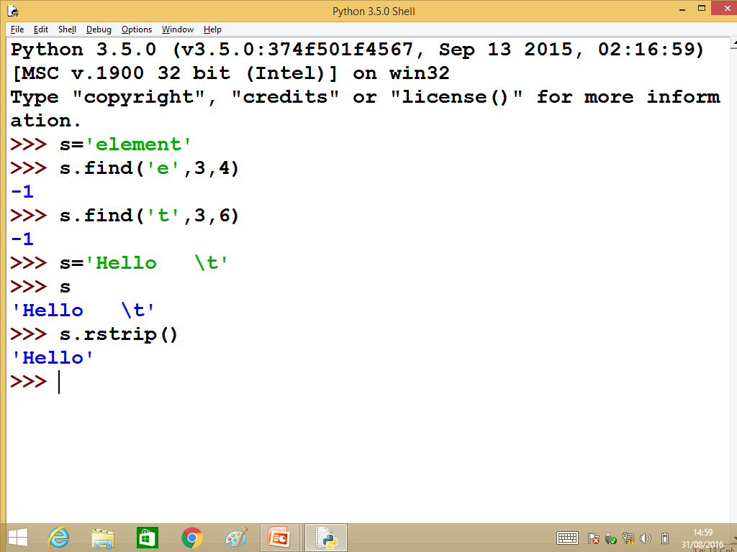

Slide 51
Other Common String Methods in Action
>>> line.isalpha()
False
>>> line.endswith('Ni!')
True
>>> line.startswith('The')
True

Slide 52
Other Common String Methods in Action
length and slicing operations can be used to mimic endswith:
>>> line = 'The knights who say Ni!\n'
>>> line.find('Ni') != −1
True
>>> 'Ni' in line
True

Slide 53
Other Common String Methods in Action
>>> sub = 'Ni!\n'
>>> line.endswith(sub) # End test via method call or slice
True

Slide 54
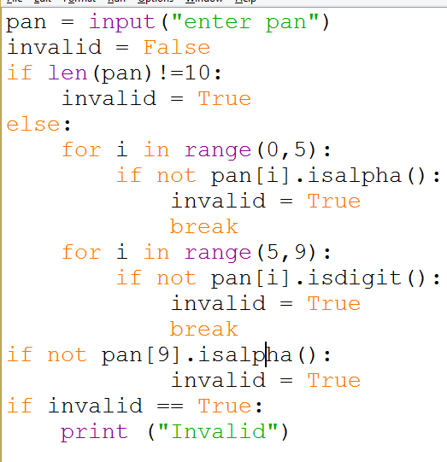
Notes:
pan=input("enter PAN")
invalid=False
if len(pan)!=10:
invalid=True
else:
for i in range(0,5):
if not pan[i].isalpha():
invalid=True
break
for i in range(5,9):
if not pan[i].isdigit():
invalid=True
break
if not pan[9].isalpha():
invalid=True
if invalid==True:
print("Invalid")

Slide 55
To check if all letters in a String are in Uppercase
isupper() function is used to check if all letters in a string are in upper case

Slide 56
Examples
>>> 'a'.isupper()
False
>>> 'A'.isupper()
True
>>> 'AB'.isupper()
True
>>> 'ABc'.isupper()
False
>>>

Slide 57
To check if all letters in a String are in Lowercase
islower() function is used to check if all letters in a string are in lower case

Slide 58
Examples
>>> 'a'.islower()
True
>>> 'aB'.islower()
False

Slide 59
To check if a sentence is in Title case
istitle() function is used to check if all letters in a string are in title case

Slide 60
Examples
>>> 'Apple Is A Tree'.istitle()
True
>>> 'Apple Is A tree'.istitle()
False

Slide 61
Looping Through Strings
Using a while statement and an iteration variable, and the len function, we can construct a loop to look at each of the letters in a string individually.
fruit = 'banana’
index = 0
while index < len(fruit) :
letter = fruit[index]
print (index, letter)
index = index + 1
Notes:
Outputt:
0 b
1 a
2 n
3 a
4 n
5 a

Slide 62
For loop
A definite loop using a for statement is much more elegant
The iteration variable is completely taken care of by the for loop
fruit = 'banana'
for letter in fruit :
print (letter)

Slide 63
Looping and Counting
This is a simple loop that loops through each letter in a string and counts the number of times the loop encounters the 'a' character.
word = 'banana'
count = 0
for letter in word :
if letter == 'a' :
count = count + 1
print (count)

Slide 64
String Comparison
word=input()
if word == 'banana':
print ( 'All right, bananas')

